Slide 1
An Introduction to
VoiceXML and the Voice Web
Kenneth G. Rehor
ken@rehor.com

Slide 2
Agenda
Voice Web Architecture
Speech Interface Framework
  VoiceXML
  Speech Grammar Markup Language
  Speech Synthesis Markup Language
Intro to VoiceXML with SRGS and SSML
  History, Motivation
  Language Overview
  Examples
  What’s Next
Voice Network Architecture
  PSTN “classic”
  VoIP using SIP and RTP
  3rd Party Call Control
  CCXML

Slide 3
Voice Web Architecture

Slide 4


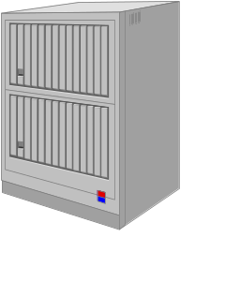
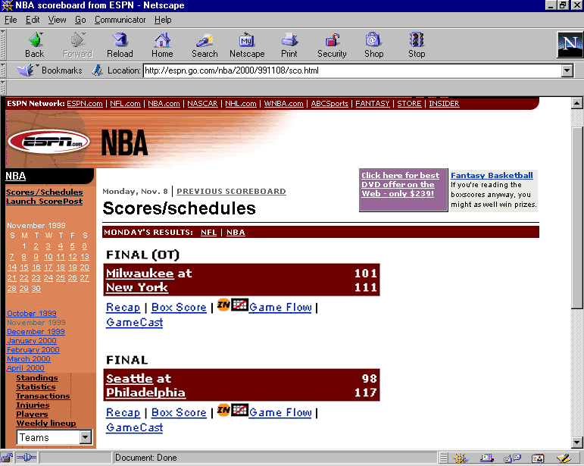
Leverage Existing Web Investments
Re-use web infrastructure, tools, database & transaction interfaces
PSTN
Phone user
<vxml>
VoiceXML
interpreter
HTTP
Internet
HTTP
<html>
Application
(web) server
HTTP
Business logic
Grammars
Prompts
Transaction processing
Database interface
Web user

Slide 5
Standards-based Voice Application Architecture
How may I
help you?
…
I have a
question
about my...
<vxml>
PSTN
HTTP
VoiceXML
server
Internet
Caller
Application
(web) server
VoiceXML
interpreter
Business logic
Grammars
Prompts
Transaction processing
Database interface
middleware
ASR
TTS
Audio
DTMF
Telephony
OA&M

Slide 6
W3C
Speech Interface Framework

Slide 7
Voice Application Components
Dialog – flow control of the inputs, outputs, next steps
Input grammars
  Control input constraints for DTMF and speech recognition
Output formatting
  Pronunciation, timing, sequencing

Slide 8
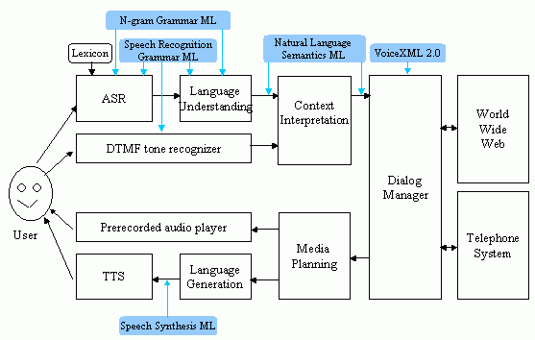
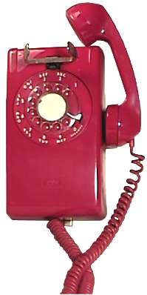
W3C Speech Interface Framework
Semantic Interpretation Tags
CCXML
Voice Browser
Interoperation

Slide 9
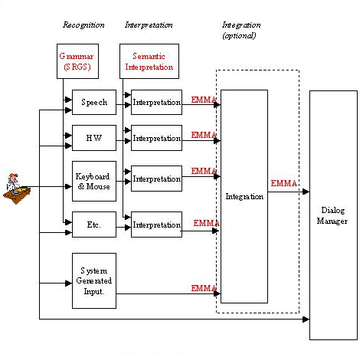
W3C Languages for User Input
VoiceXML

Slide 10
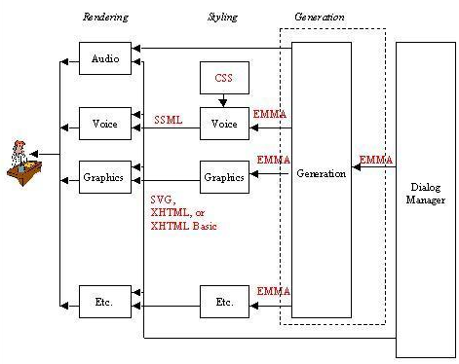
W3C Languages for System Output
VoiceXML

Slide 11
W3C Speech Recognition Grammar Specification
Markup language to control input constraints
  Finite-state speech recognition
  DTMF recognition
Two variations
  XML (GRXML)
  ABNF
Candidate Recommendation – June 2002
Implemented and supported by numerous vendors
  Nuance, Speechworks, VoiceGenie, Tellme, etc.

Slide 12
W3C Speech Recognition Grammar Specification
<grammar type="application/srgs+xml" root="r2" version="1.0">
<rule id="r2" scope="public">
<one-of>
<item>coffee</item>
<item>tea</item>
<item>milk</item>
<item>nothing</item>
</one-of>
</rule>
</grammar>
asdf

Slide 13
W3C Speech Synthesis Markup Language
Markup language to control spoken output
Modeled after Sun’s Java Speech Markup Language and Bell Labs’ SABLE
Nearing the Last Call Working Draft state
(required for VoiceXML 2.0 Candidate Recommendation)
Implemented and supported by numerous vendors
  Nuance, Speechworks, VoiceGenie, Tellme, etc.

Slide 14
Speech Synthesis ML
(Modeled after JSML)
Structure
Analysis
Text
Normali-
zation
Text-to-
Phoneme
Conversion
Prosody
Analysis
Waveform
Production
<paragraph>
<sentence>
This is the first sentence.
</sentence>
<sentence>
This is the second sentence.
</sentence>
</paragraph>
Non-markup behavior:
infer structure by
automated text analysis
Markup support:
paragraph, sentence
More…

Slide 15
Speech Synthesis Process
Structure
Analysis
Text
Normali-
zation
Text-to-
phoneme
Conversion
Prosody
Analysis
Waveform
Production
Doctor Jones lives at one seventy-five Park Drive. He weights one hundred seventy-five pounds. He plays bass in a blues band. He likes to fish; last week he caught a twenty-pound bass.
Dr. Jones lives at 175 Park Dr. He weights 175 lbs. He plays bass in a blues band. He also likes to fish; last week he caught a 20 lb. bass.
More…

Slide 16
Speech Synthesis ML
(Modeled after JSML)
Structure
Analysis
Text
Normali-
zation
Text-to-
Phoneme
Conversion
Prosody
Analysis
Waveform
Production
Elements
sub
acronym
number: digits, ordinal
date: dmy, mdy, ymd, ym, my, md, y
time: hm, hms
duration: hm, hms, ms
currency
measure
name
net: e-mail, url
address
Non-markup behavior:
automatically identify
and convert constructs
Markup support:
sayas for dates, times, etc.
Examples
<sayas sub="World Wide Web Consortium" > W3C</sayas>
<sayas type="number:digits"> 175 </sayas>
More…

Slide 17
Speech Synthesis ML
(Modeled after JSML)
Structure
Analysis
Text
Normali-
zation
Text-to-
phoneme
Conversion
Prosody
Analysis
Waveform
Production
Non-markup behavior:
look up in a pronunciation
dictionary
Markup support:
phoneme, sayas
International Phonetic
Alphabet (IPA) using
character entities
Example
<phoneme ph="t&#252;m&251;to&#28A;"> tomato </phoneme>
More…

Slide 18
Phonetic Alphabets
International Phonetic Alphabet (IPA) is the standard.
  Primarily used by linguists to capture spoken language in print
  Arranged in order of their resemblance to Latin characters “a” through “z” rather than by their phonetic similarity
  Occupies 0x0250 through 0x02aF of Unicode
Each text-to-speech and speech recognition engine uses its own phonetic character set.

Slide 19
Speech Synthesis ML
(Modeled after JSML)
Structure
Analysis
Text
Normali-
zation
Text-to-
phoneme
Conversion
Prosody
Analysis
Waveform
Production
Examples
<emphasis> Hi </emphasis>
<break time="3s"/>
<prosody rate="slow"/>
Prosody element
pitch: high, medium, low, default
contour
range: high, medium, low, default
rate: fast medium, slow, default
volume: silent, soft medium, loud, default
Non-markup behavior:
automatically generates
prosody through analysis
of document structure and
sentence syntax
Markup support:
emphasis, break, prosody
More…

Slide 20
Speech Synthesis ML
(Modeled after JSML)
Structure
Analysis
Text
Normali-
zation
Text-to-
phoneme
Conversion
Prosody
Analysis
Waveform
Production
Examples
<audio src="beep.wav"/>
<voice age="child"> Mary had a little lamb </voice>
Attributes
gender: male, female, neutral
age: child, teenager, adult, elder, (integer)
variant: different, (integer)
name: default, (voice-name)
Markup support:
voice, audio

Slide 21
Speech Synthesis ML Examples
<paragraph>
<sentence>
<sayas sub="Doctor"> Dr. </sayas> Jones lives at
<sayas type="number:digits"> 175 </sayas> Park
<sayas sub="Drive"> Dr. </sayas>
</sentence>
<sentence>
He weighs
<sayas sub="one hundred and seventy five"> 175 </sayas>
<sayas sub="pounds"> lb. </sayas>
</sentence>
</paragraph>

Slide 22
W3C Natural Language Semantics
Transitioned from VBWG to MMIWG:
  created a subgroup to work on the next version of NLSML
  subgroup is generalizing NLSML into the Extensible Multimodal Annotation Markup Language (EMMA)
  subgroup has been working on requirements for this new language
  subgroup is beginning to work on the language definition itself

Slide 23
W3C CCXML
Call Control Markup Language
State machine language for controlling connections
Working Draft published – February 2002
Handful of implementations
Designed for 3rd Party Call Control
Call Control
Web
Server
Voice App
Web
Server
CCXML
Interpreter
Signaling
Signaling
PSTN
VoIP
Gateway
VoiceXML
Interpreter
Voice
caller

Slide 24
VoiceXML

Slide 25
Early Voice Markup Languages
Phone Markup Language – PML (AT&T, Lucent)
  Version 1: <prompt>, <collect>, <audio>; implied state machine
  AT&T new PML: Version 1 + "Interaction Definition Language" for low-level control; implied and explicit state machines
  Lucent new PML: <audio>, <input>, HTML features plus implied voice navigation; implied state machine; implied "browser" mode
  Lucent "PML2": XML-based dialog language (sketched but not finished; concepts evolved into VoiceXML)
VoxML (Motorola)
  XML-based
  Explicit dialog states based on WML
Speech Markup Language – SpeechML (IBM)
  XML-based
  Global scoping of grammars

Slide 26




The Evolution of Early Voice Markup Languages
2000
1995
B. D. Lucas
L. Boyer
Speech Markup Language
J. Ferrans
G. Karam
N. Klarlund
P. Danielsen
TM
VoxML
PML
PML
J. C. Ramming
K. G. Rehor
D. A. Ladd 2/96
C. D. Tuckey 11/98
Bell Labs
MAWL/PML/PhoneWeb

Slide 27
VoiceXML 2.0 Evolution
VoiceXML 1.0
Speech Grammar languages
  Nuance GSL, JSML, SpeechWorks whatever, Pipebeach Grammar XML, ???
Speech Synthesis markup languages
  SABLE, JSML
TML – Tellme

Slide 28
What is VoiceXML?
High-level, domain-specific language
Supports simple or complex speech dialogs
Control speech and telephony resources in uniform manner
  High-level abstraction of platform capabilities
Shield application programmers from platform details
  No need to know ASR, TTS, telephony APIs
Common service creation
  Content providers, Tool providers, Platform providers
Enables portability
  Run on any supported platform, whether an enterprise system or in telephone network
Notes:
Enterprises consolidate two services with the same functionality into one service that’s presented to the end user in different ways, e.g., by web browser or by voice.
Enterprises provide a single point of access to many different services.

Slide 29
VoiceXML: Goals
Declarative model prevents client-side loops, permits static analysis
  Executable elements and script negate this
Abstractions of voice dialogs simplify application development
  Hide platform details; let platform builder deal with details, resource management, etc.
  FIA provides a form-filling approach, not good for list traversal, navigation of voice streams (e.g. voice messaging apps)
  Built-in execution algorithms and rules simplify and complicate development
    If it is what you want, it is easy
    Can modify execution of FIA via script, etc.

Slide 30
VoiceXML Scope
VoiceXML
Application
Voice Dialogs
  Audio Output
    text to speech
    audio files
  Audio Input
    speech recognition
    audio recording
  Character Input
    DTMF
  Dialog sequencing
Basic Connection Control
  Disconnect
  Transfer
General Service Logic
State Management
Dialog Generation
Dialog Sequencing
Database Operations
Legacy System Operations

Slide 31
VoiceXML: key concepts
Abstractions of voice interactions:
  Picking items from a list of <choice>s in a <menu>, then transitioning to another dialog (<menu> and <choice> using Menu Interpretation Algorithm) [uses grammar generation method described in 2.2]
  Picking items from a list of <option>s in a field, return a semantic representation of a user utterance (<form>, <field>, <option> using the Form Interpretation Algorithm) [uses grammar generation method described in 2.2]
  Form filling, possibly using multiple fields (<form> and <field> using the Form Interpretation Algorithm)
Interpreter execution
  Only begins once an incoming call is answered ( there's a connection to a user)
  May continue after user disconnection until another I/O operation, for cleanup purposes
Scoping of grammars, variables
ECMAScript/VoiceXML variable binding model (when are 'expr' attributes executed? At document initialization, or at run time?)
Basic telephony
  <transfer>, <disconnect>

Slide 32
VoiceXML: key concepts
Declarative language constructs
  XML application
Imperative script execution for client-side processing
Queued prompts
Single-threaded execution model; Synchronous
Tapered prompting via 'count' attribute
Executable content:
  Conditional logic elements: <if>, <elseif>, <else>
  variables: <var>, <assign>, <clear>
  <block>, <filled>, <prompt>, <reprompt>, <goto>, <submit>, <exit>, <return>
  event handlers
<subdialog>
  A way to factor out common code, but not quite a subroutine/function call

Slide 33
Voice and Multimodal Technology Design Choices
Dialog vs.
“High-level” vs.
Synchronous vs.
Audio-specific vs.
Interface-specific vs.
Declarative vs.
Structure vs.
Call Control
“Low-level”
Asynchronous
Multimodal
Interface-agnostic
Procedural
Presentation

Slide 34
Most Basic Example
<?xml version="2.0"?>
<vxml version="2.0" xmlns="http://www.w3.org/2001/vxml"
xmlns:xsi="http://www.w3.org/2001/XMLSchema-instance"
xsi:schemaLocation="http://www.w3.org/2001/vxml
http://www.w3.org/TR/voicexml20/vxml.xsd">
<form>
<block>
<prompt> Hello, World! </prompt>
</block>
</form>
</vxml>
hello.vxml
Notes:
Is the id required if only one <dialog>? Only if dialog isn’t going to be referenced somewhere else...
Is this the proper header/footer?

Slide 35
Collect Input – VoiceXML <menu>
<?xml version="1.0"?>
<vxml version="2.0"?>
<menu>
<prompt>Would you like <enumerate/></prompt>
<choice next=“http://…coffee.vxml”>coffee</choice>
<choice next=“http://…tea.vxml”>tea</choice>
<choice next=“http://…milk.vxml”>milk</choice>
<choice next=“http://…nothing.vxml”>nothing</choice>
</menu>
</vxml>
drink_menu.vxml
Notes:
Is this the simplest way to do an input?
How to do this with <choice> or <link>?

Slide 36
Collecting Input – VoiceXML <form>
<?xml version="1.0"?>
<vxml version="2.0" >
<form>
<field name="drink">
<prompt>Would you like coffee, tea, milk, or nothing?</prompt>
<grammar src="drink.grxml" type="application/srgs+xml"/>
</field>
<block>
<submit next="http://www.drink.example.com/drink2.asp"/>
</block>
</form>
</vxml>
drink.vxml
Notes:
Is this the simplest way to do an input?
How to do this with <choice> or <link>?

Slide 37
Collecting Input - grammar
<grammar type="application/srgs+xml" root="r2" version="1.0">
<rule id="r2" scope="public">
<one-of>
<item>coffee</item>
<item>tea</item>
<item>milk</item>
<item>nothing</item>
</one-of>
</rule>
</grammar>
drink.grxml
Notes:
Is this the simplest way to do an input?
How to do this with <choice> or <link>?

Slide 38
Directed Dialog Example - VoiceXML
<?xml version="1.0" encoding="UTF-8"?>
<vxml version="2.0">
<form id="get_card_info">
<block>
<prompt> We now need your credit card type, number, and expiration date.</prompt>
</block>
<field name="card_type">
<prompt count="1"> What kind of credit card do you have? </prompt>
<prompt count="2"> Type of card? </prompt>
<!-- This is an inline grammar. -->
<grammar type="application/srgs+xml" root="r2" version="1.0">
<rule id="r2" scope="public">
<one-of>
<item>visa</item>
<item>master <item repeat="0-1">card</item></item>
<item>amex</item>
<item>american express</item>
</one-of>
</rule>
</grammar>
<help> <prompt> Please say Visa, Mastercard, or American Express. <prompt> </help>
</field>
credit_card.vxml

Slide 39
Directed Dialog Example (continued)
<field name="card_num">
<grammar type="application/srgs+xml" src="/grammars/digits.grxml"/>
<prompt count="1">What is your card number?</prompt>
<prompt count="2">Card number?</prompt>
<catch event="help">
<if cond="card_type =='amex' || card_type =='american express'">
<prompt> Please say or key in your 15 digit card number. </prompt>
<else/>
<prompt> Please say or key in your 16 digit card number. </prompt>
</if>
</catch>
<filled>
<if cond="(card_type == 'amex' || card_type =='american express')
&amp;&amp; card_num.length != 15">
<prompt> American Express card numbers must have 15 digits. </prompt>
<clear namelist="card_num"/>
<throw event="nomatch"/>
<elseif cond="card_type != 'amex' &amp;&amp; card_type !='american express'
&amp;&amp; card_num.length != 16"/>
<prompt> Mastercard and Visa card numbers have 16 digits. </prompt>
<clear namelist="card_num"/>
<throw event="nomatch"/>
</if>
</filled>
</field>

Slide 40
Directed Dialog Example (continued)
<field name="expiry_date">
<grammar type="application/srgs+xml" src="/grammars/digits.grxml"/>
<prompt count="1">What is your card's expiration date?</prompt>
<prompt count="2">Expiration date?</prompt>
<help> Say or key in the expiration date, for example one two oh one. </help>
<filled> <!-- validate the mmyy --> <var name="mm"/>
<var name="i" expr="expiry_date.length"/>
<if cond="i == 3">
<assign name="mm" expr="expiry_date.substring(0,1)"/>
<elseif cond="i == 4"/>
<assign name="mm" expr="expiry_date.substring(0,2)"/>
</if>
<if cond="mm == '' || mm &lt; 1 || mm &gt; 12">
<clear namelist="expiry_date"/>
<throw event="nomatch"/>
</if>
</filled>
</field>

Slide 41
Directed Dialog Example (continued)
<field name="confirm">
<grammar type="application/srgs+xml" src="/grammars/boolean.grxml"/>
<prompt> I have <value expr="card_type"/> number <value expr="card_num"/>,
expiring on <value expr="expiry_date"/>. Is this correct? </prompt>
<filled>
<if cond="confirm">
<submit next="place_order.asp" namelist="card_type card_num expiry_date"/>
</if>
<clear namelist="card_type card_num expiry_date acknowledge"/>
</filled>
</field>
</form>
</vxml>
weather.vxml

Slide 42
Mixed Initiative Dialog - VoiceXML
<vxml>
<form id="weather_info">
<grammar src=”weather.gram#cityandstate"/>
<!-- Caller can't barge in on today's advertisement. -->
<block>
<prompt bargein="false">
Welcome to the weather information service.
Buy Joe's Spicy Shrimp Sauce.
</prompt>
</block>
<initial name="start">
<prompt>
For what city and state would you like the weather?
</prompt>
<help>
Please say the name of the city and state for which you
you would like a weather report.
</help>
<noinput count="1"><reprompt/></noinput>
<noinput count="2"><assign name="start" expr="true"/></noinput>
</initial>
weather.vxml

Slide 43
Mixed Initiative Dialog - VoiceXML (continued)
<field name="state">
<prompt>What state?</prompt>
<help>Please speak the state for which you want the weather.</help>
</field>
<field name="city">
<prompt>
Please tell us the city for which you want the weather?
</prompt>
<help>Please speak the city for which you want the weather.</help>
<filled>
<!-- Most of our customers are in LA. -->
<if cond="city == 'Los Angeles' &amp;&amp; state == undefined">
<assign name="state" expr="'California'"/>
</if>
</filled>
</field>

Slide 44
Mixed Initiative Dialog - VoiceXML (continued)
<field name="go_ahead" type="boolean" modal="true">
<prompt>
Do you want to hear the weather for
<value name="city"/>, <value name="state"/>?
</prompt>
<filled>
<if cond="go_ahead == true">
<prompt bargein="false">
Don't forget, buy Joe's Spicy Shrimp Sauce.
</prompt>
<goto next="http://localhost:8080/servlet/ex19"
submit="city state"/>
</if>
<clear name="city state go_ahead"/>
</filled>
</field>
</form>
</vxml>

Slide 45
Directed Dialog Example - grammar
#JSGF V1.0;
grammar weather;
public <cityandstate> =
<city> {this.city=$} [<state> {this.state=$}] |
<state> {this.state=$} [<city> {this.state=$}] ;
<city> = Los Angeles | Palo Alto | San Francisco | Yorktown Heights;
<state> = California | New York;
weather.gram

Slide 46
VoiceXML Today
3 years of implementation experience

Slide 47
Today: Current status of VoiceXML Implementation
VoiceXML v2.0 published
  Last Call Working Draft published April 24, 2002
35 VoiceXML Platforms/Interpreters
25 VoiceXML service providers
10’s of VoiceXML development tools
  PC and web-based
10’s of VoiceXML application servers and components suppliers
100’s of VoiceXML application development companies
10,000+ VoiceXML application developers

Slide 48
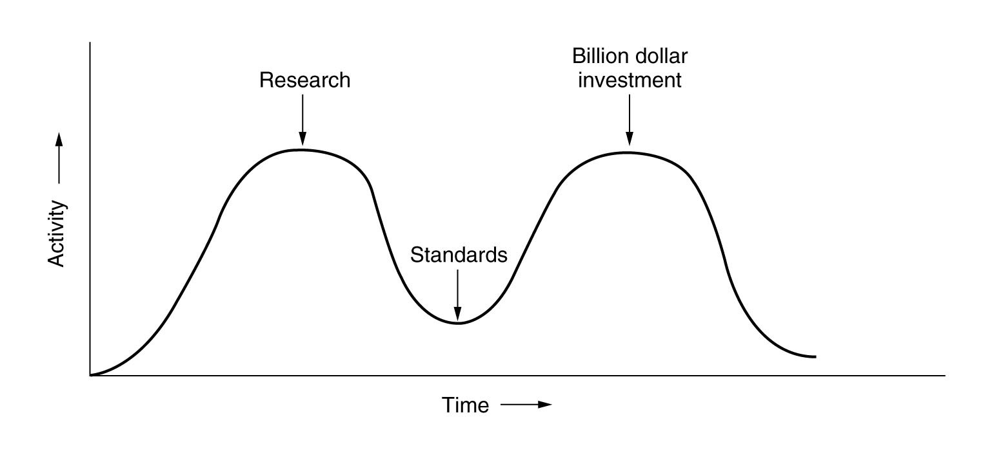
VoiceXML: Innovation vs. Standardization
VoiceXML 2.0

Slide 49
Vendor-specific VoiceXML extensions
Aren’t inherently bad
Features are migrating to other vendors
  Sign of a healthy standard
Drive evolution of the standard
  Sets the stage for future standardization

Slide 50
VoiceXML Portability and Conformance
Vendors have a love / hate relationship with strict conformance
  Real standards depend on clear measurement of conformance
Conformance: Technology and Policy
  Technology: quantitative measure of implementations
  Policy: everyone must agree to language definition, terminology

Slide 51
VoiceXML and VoIP
Architectural Elements of
Next-Generation Telephone Services

Slide 52
Overview
VoIP Overview
  Connection Protocols
  Audio Protocols
Voice Application Deployment Architecture
  PSTN
  VoIP (SIP)
VoIP advantages
  Flexible Network Topology
  Complex call routing

Slide 53
VoIP Overview
Connection Protocols
  SIP, H.323
Media Protocols
  RTP, RTCP, RTSP

Slide 54
VoIP Connection Protocols
Session Initiation Protocol
  Lightweight, extensible
  Based on HTTP and SMTP
  Developed in IETF
  Latest draft spec: RFC2543
  http://search.ietf.org/internet-drafts/draft-ietf-sip-rfc2543bis-09.txt
  See http://www.jdrosen.net/
H.323
  Originally designed for audiovisual conferencing
  Popular with VoIP audio-only media connections
  Developed in ITU

Slide 55
VoIP Media Transport Protocols
RTP – Real Time Protocol
  Developed in IETF
  RFC 1889
  Latest draft http://www.ietf.org/internet-drafts/draft-ietf-avt-rtp-new-11.txt
RTCP – Real Time Control Protocol
  Developed in IETF
  Compliment to RTP
RTSP – Real Time Streaming Protocol
  Developed in IETF
  RFC 2326

Slide 56
Inbound call using PSTN connections
Speech resources and telephony integrated
VWS handles call routing/setup/answer
PSTN
VoiceXML
Server
Caller

Slide 57
Inbound call using VoIP (SIP and RTP)
Speech resources and telephony integrated
VWS handles call routing/setup/answer
PSTN
VoIP
Gateway
1. INVITE
VoiceXML
Server
2. RTP
customer

Slide 58
3rd Party Call Control
CCXML
Server
Signaling
Signaling
PSTN
VoIP
Gateway
VoiceXML
Server
Voice
caller

Slide 59
3rd Party Call Control
Inbound call using VoIP (SIP and RTP)
Speech resources and telephony integrated
3rd party application handles call routing/setup/answer
Call Routing
Application
PSTN
VoIP
Gateway
1. INVITE
2. INVITE
VoiceXML
Server
3. RTP
customer

Slide 60
3rd Party Call Control
Outbound call using VoIP (SIP and RTP)
Speech resources and telephony integrated
3rd party call control application initiates call
Outbound
Calling
Application
PSTN
VoIP
Gateway
1. INVITE
2. INVITE
VoiceXML
Server
3. RTP
customer

Slide 61
3rd Party Call Control
Application
Web
Server
XML over
HTTP
CCXML
Server
PSTN
VoIP
Gateway
SIIP
SIP
VoiceXML
Server
VoiceXML
Server
RTP
VoiceXML
Server
customer

Slide 62
3rd Party Call Control
Call Control
Web
Server
Call Control
Web
Server
XML over
HTTP
CCXML
Server
XML over
HTTP
PSTN
VoIP
Gateway
SIIP
SIP
VoiceXML
Server
VoiceXML
Server
RTP
VoiceXML
Server
customer

Slide 63
Advantages of VoIP for VoiceXML Deployments
Flexible Network Topology
Simplified integration of voice dialog resources
Vendor independence for network elements
Separation of concerns: voice dialog resources vs. call control

Slide 64
What’s Next?
Evolution of voice standards and industry

Slide 65


Road to VoiceXML 2.0
VoiceXML 2.0
standard
VoiceXML 1.0
specification
Member submissions
& change requests
PML, VoxML, SpeechML

Slide 66
The Road Beyond VoiceXML 2.0
VoiceXML 2.0
standard*
VoiceXML 3.0
standard*
Member submissions
& change requests
Member submissions
& change requests
* Including SRGS, SSML and other Speech Interface Framework specs

Slide 67
Voice and Multimodal Technology Design Choices
Dialog vs.
“High-level” vs.
Synchronous vs.
Audio-specific vs.
Interface-specific vs.
Declarative vs.
Structure vs.
Call Control
“Low-level”
Asynchronous
Multimodal
Interface-agnostic
Procedural
Presentation

Slide 68
Multimodal languages - not-yet-standards-track :
MobileXML – Oracle
  Initially designed to abstract the differences of small-screen devices
  Expanded to support VoiceXML for simple dialogs
  High-level language, generates target language tailored to device
    WML, cHTML, VoiceXML
XHTML + Voice profile – IBM, Opera, Motorola
  Use W3C technologies and techniques to combine existing W3C user interface languages
SALT – SALT Forum / Microsoft
  Speech and telephony features that can be added to other XML-based languages
Other proposals / solutions
  Alcatel, Kirusa, Siemens, Vialto

Slide 69
Multimodal markup languages: Innovation vs. Standardization
Multimodal markup
languages

Slide 70
SALT
Speech enabler or cause of high blood pressure?

Slide 71
SALT: key concepts
No declarative constructs
  XML application
Imperative (Turing Machine) script execution for client-side processing
All actions are events
  e.g. begin of speech, end of speech, timers, etc.
Event handlers required to handle all events
Prompt model ???
Few language primitives: provide primitives; run a script to use them
  Output
    <prompt>
  Input
    <listen> - speech
    <dtmf> - DTMF
Execution model ???
  Declare "onRun()" function
  onRun() executes scripts, event handlers, etc.
Interpreter execution
  When does it start and end? Does it "live" longer than a call?
Telephony object model
  Advanced telephony features available via object and scripts
    Transfer, conferencing, outbound calling
External messaging
  <smex> - simple message exchange to send and receive messages

